Slide 1
BOOTP and DHCP

Slide 2
Problem with RARP
There is a serious problem with RARP: Broadcasting is done at the data link layer.
RARP is a link layer protocol and the problem of RARP is that you can’t route these packets. You need a RARP server on every subnet.
The physical broadcast address, all is in the case of Ethernet, does not pass the boundaries of a network.
This means that if an administrator has several networks or several subnets, it needs to assign a RARP server for each network or subnet. This is the reason that RARP is almost obsolete.
Two protocols, BOOTP and DHCP replaces RARP

Slide 3
BOOTP or Bootstrap Protocol
Protocol used in Internet Protocol networks to automatically assign an IP address to network devices from a configuration server.
BOOTP (Bootstrap Protocol) is the successor of RARP (Reverse ARP) and the predecessor of DHCP.
BOOTP uses the UDP transport protocol (port 67 and 68) and rides on top of IP so it can be routed.
BOOTP supports relay servers so you can have a central BOOTP server that assigns IP addresses to hosts in all of your subnets.
It also provides a diskless workstation with additional information, including the IP address of the file server holding the memory image, the IP address of the default router, and the subnet mask to use.

Slide 4
Working of Bootstrap Protocol :
The address allocation via BOOTP is based on a simple two-step message exchange between client and server
Client component is the initiator.
As the client does not know its own IP address nor that of the BOOTP server at the start, it sends a general request (“BOOTREQUEST”) to the broadcast group address 255.255.255.255.
The server, listening on UDP port 67, receives and processes this request by allocating a suitable IP address to the MAC address of the client system.
Then the response (“BOOTREPLY”) including further network information is sent back to the client via broadcast, which can receive the operating system via the network as a result.
If the client already knows the address of the BOOTP server, it can also send this request directly via unicast connection.

Slide 5
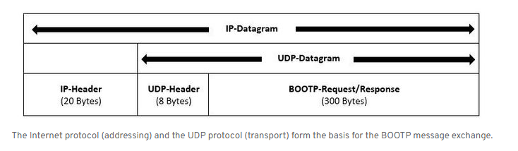
BOOTP messages
BOOTP messages may also be up to 2,400 bits long (300 bytes)

Slide 6
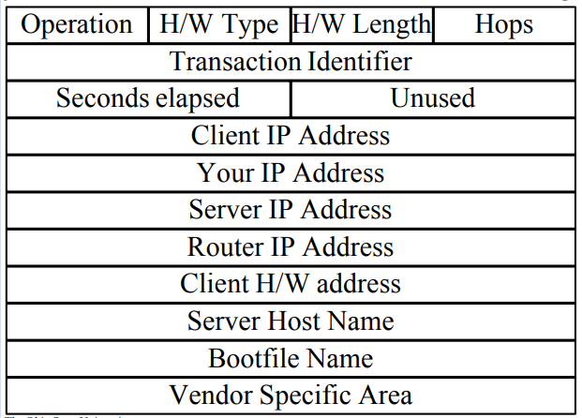
BOOTP MESSAGE FORMAT

Slide 7
BOOTP MESSAGE FORMAT
• Operation Code: Specifies the type of message. A value of 1 indicates a request (BOOTREQUEST message) while a value of 2 is a reply (BOOTREPLY message).
• Operation Code: Specifies the type of message. A value of 1 indicates a request (BOOTREQUEST message) while a value of 2 is a reply (BOOTREPLY message).
• Hardware Type Denotes the type of hardware technology being used. For example, if the hardware type is Ethernet, this field holds the value 1.
Hardware Address Length: Specifies how long hardware addresses are in this message. For Ethernet or other networks using IEEE 802 MAC addresses, the value is 6.
Hops: Specify the number of relay agents or routers through which the message has to travel between client and the server .client sets it to 0 before transmission and is incremented at each router.
Transaction Identifier: A 32-bit identification field generated by the client, to allow it to match up the request with replies received from BOOTP servers. Or used to match responses with requests
Seconds: This field contains the number of seconds “elapsed since the client started trying to boot”.
This is supposed to provide information to BOOTP servers to help them decide which requests to respond to first.

Slide 8
BOOTP MESSAGE FORMAT
Client IP Address: If the client has a current IP address that it plans to keep using, it puts it in this field. By filling in this field, the client is committing to responding to unicast IP datagrams sent to this address. Otherwise, it sets this field to all zero to tell the server it wants an address assigned.
Your” IP Address: The IP address that the server is assigning to the client. This may be different than the IP address currently used by the client
Server IP Address: The IP address of the BOOTP server sending a BOOTREPLY message.
Router IP Address: The IP address of the Router

Slide 9
BOOTP MESSAGE FORMAT
Client Hardware Address: The hardware (layer two) address of the client sending a BOOTREPLY. It is used both to look up a device's assigned IP address and also possibly in delivery of a reply message
Server Name: The server sending a BOOTREPLY may optionally put its name in this field. This can be a simple text “nickname” or a fully-qualified DNS domain name (such as “myserver.organization.org”).
Boot Filename: Contains the full directory path and file name of a boot file the client requires to start the operating
Vendor-Specific Area: Originally created to allow vendors to customize BOOTP to the needs of different types of hardware

Slide 10
Problem with BOOTP
A serious problem with BOOTP is that it requires manual configuration of tables mapping IP address to Ethernet address.
When a new host is added to a LAN, it cannot use BOOTP until an administrator has assigned it an IP address and entered its (Ethernet address, IP address) into the BOOTP configuration tables by hand.
To eliminate this error-prone step, BOOTP was extended and given a new name: DHCP (Dynamic Host Configuration Protocol).

Slide 11
DHCP
Dynamic Host Configuration Protocol

Slide 12
Drawback of RARP and BOOTP
Before DHCP, two protocols, namely RARP and BOOTP were used for assigning IP addresses to end nodes. Both were client server protocols primarily used by end clients to get an IP address.
RARP is a layer 2 broadcast protocol and since routers do not forward broadcast packets, the RARP server is required to be present in the same network as the clients.
This necessitated every network to have a dedicated RARP server.
To overcome this problem with RARP, BOOTP was developed, using UDP as the transport layer protocol.
BOOTP required manual administration at the server end for entering the IP address and other information pertaining to each client.
Hence, BOOTP does not scale well for large networks with more number of clients.
To overcome the problem of BOOTP, DHCP was developed as an enhancement of BOOTP. DHCP was devised in a way such that both client and server administration could be done automatically, with minimal manual intervention.

Slide 13
Dynamic Host Configuration Protocol (DHCP)
Dynamic Host Configuration Protocol (DHCP) is a network management protocol used to dynamically assign an IP address to any device, or node, on a network so they can communicate using IP (Internet Protocol).
• DHCP automates and centrally manages these configurations.
There is no need to manually assign IP addresses to new devices.
DHCP is the default protocol used by the most routers and networking equipment.
It is a Client server protocol which uses UDP services.

Slide 14
DHCP
DHCP stands for dynamic host configuration protocol and is a network protocol used on IP networks where a DHCP server automatically assigns an IP address and other information to each host on the network so they can communicate efficiently with other endpoints.
IP address is assigned from a pool of addresses.
In DHCP, the client and the server exchange mainly 4 DHCP messages in order to make a connection, also called DORA process, but there are 8 DHCP messages in the process.
In addition to the IP address, DHCP also assigns the subnet mask, default gateway address, domain name server (DNS) address and other pertinent configuration parameters

Slide 15
Need for DHCP
The primary reason DHCP is needed is to simplify the management of IP addresses on networks.
No two hosts can have the same IP address, and configuring them manually will likely lead to errors.
Even on small networks manually assigning IP addresses can be confusing, particularly with mobile devices that require IP addresses on a non-permanent basis.
Also, most users aren’t technically proficient enough to locate the IP address information on a computer and assign it.
Automating this process makes life easier for users and the network administrator.

Slide 16
Components of DHCP
DHCP server:
DHCP client:
IP address pool:.
Subnet:
Lease:
DHCP relay:

Slide 17
Components of DHCP
DHCP server: A networked device running the DCHP service that holds IP addresses and related configuration information. This is most typically a server or a router
DHCP client: The endpoint that receives configuration information from a DHCP server.
This can be a computer, mobile device, IoT endpoint or anything else that requires connectivity to the network.
IP address pool: The range of addresses that are available to DHCP clients. Addresses are typically handed out sequentially from lowest to highest.

Slide 18
Components of DHCP
Subnet: IP networks can be partitioned into segments known as subnets. Subnets help keep networks manageable.
Lease: The length of time for which a DHCP client holds the IP address information. When a lease expires, the client must renew it.
DHCP relay: A router or host that listens for client messages being broadcast on that network and then forwards them to a configured server. The server then sends responses back to the relay agent that passes them along to the client.
This can be used to centralize DHCP servers instead of having a server on each subnet.
It is useful if the networks that do not have a dedicated DHCP server.

Slide 19
IP allocation methods by DHCP
DHCP server may have three methods of allocating IP-addresses:
Static allocation:
Dynamic allocation:
Automatic allocation:

Slide 20
IP allocation methods by DHCP
static allocation: The DHCP server allocates an IP address based on a table with MAC address/IP address pairs, which are manually filled.
Only requesting clients with a MAC address listed in this table will be allocated an IP address.
dynamic allocation: A network administrator assigns a range of IP addresses to DHCP, and each client computer on the LAN is configured to request an IP address from the DHCP server during network initialization.
automatic allocation: The DHCP server permanently assigns a free IP address to a requesting client from the range defined by the administrator. This is like dynamic allocation, but the DHCP server keeps a table of past IP address assignments, so that it can preferentially assign to a client the same IP address that the client previously had.
Among these three method static and dynamic method are the most popular implementation.

Slide 21
Working of DHCP
DHCP provides an automated way to distribute and update IP addresses and other configuration information on a network.
A DHCP server provides this information to a DHCP client through the exchange of a series of messages, known as the DHCP conversation or the DHCP transaction.
Before learning the process through which DHCP achieves it’s goal, we first have to understand the different messages that are used in the process.

Slide 22
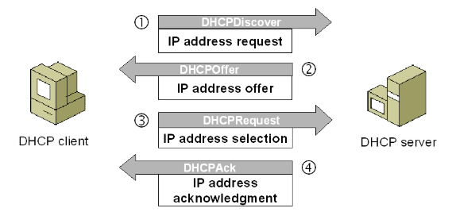
Working of DHCP

Slide 23
Working of DHCP
End nodes, on bootup, initiate a 4-way handshake message with a nearby DHCP server (as shown in the diagram ), in order to automatically get their IP address and other network related parameters.
DHCP operations fall into four phases:
DHCP discovery
DHCP offer
DHCP request
DHCP acknowledgement
These stages are often abbreviated as DORA for discovery, offer, request, and acknowledgement.
The DHCP operation begins with clients broadcasting a request

Slide 24
Working of DHCP
DHCP discovery
The client computers broadcasts messages on the physical subnet to discover available DHCP servers.
This client-computers creates a User Datagram Protocol (UDP) packet with the default broadcast destination of 255.255.255.255 or the specific subnet broadcast address if any configured.
DHCP offer
When a DHCP server receives an IP lease request from a client, it reserves an IP address for the client and extends an IP lease offer by sending a DHCPOFFER message to the client.
This message contains the client's MAC address, the IP address that the server is offering, the subnet mask, the lease duration, and the IP address of the DHCP server making the offer.

Slide 25
Working of DHCP
DHCP request
Client could receive DHCP offers from multiple servers
But it will accept only one DHCP offer.
In response to the offer ,Client requests the server to allocate the offered IP address
Based on the Transaction ID field in the request, servers are informed whose offer the client has accepted.
When other DHCP servers receive this message, they withdraw any offers that they might have made to the client and return the offered address to the pool of available addresses.

Slide 26
Working of DHCP
DHCP acknowledgement
When the DHCP server receives the DHCPREQUEST message from the client, the configuration process enters its final phase.
The acknowledgement phase involves sending a DHCPACK packet to the client and allocating offered IP address to client.
This packet includes the lease duration and any other configuration information that the client might have requested.
At this point, the IP configuration process is completed.

Slide 27
Advantages of DHCP
Simplifies the IP address assignment process of network administrators, as the whole process of IP address assignment can be automated. Using DHCP, devices can get their IP addresses and network related parameters automatically on boot up, without manual intervention, thereby facilitating a plug-n-play approach.
DHCP optimally uses IP address space, as DHCP mandates periodic renewal of assigned IP addresses. Those assigned IP addresses that are not renewed can be used for new end nodes.
DHCP supports both static and dynamic modes of IP addresses assignment and both these modes can coexist together. On a need basis, some nodes could always be assigned the same static IP addresses, based on their device identity like MAC addresses, while rest of the nodes could be assigned dynamic addresses from a pool of IP addresses configured on the DHCP server.
DHCP can be used to assign not only IP addresses, but also a wide range of additional network parameters like default gateway, DNS server address etc.
DHCP framework permits vendor specific options to be included inside DHCP messages, so that end nodes can be assigned even vendor specific parameters.
With routers acting as DHCP relay agents, even end nodes that do not have a DHCP server in their network, can communicate with remote DHCP servers, to get their IP address and other network related parameters.
DHCP supports both IPV4 and IPV6 address assignments.

